Slide 1





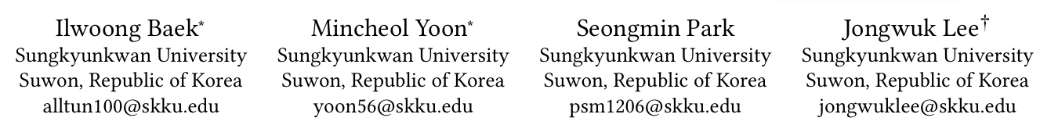





ATAI
Advanced Techniqueof Artificial Intelligence
ATAI
ChongqingUniversity _{AdvancedTechniqueof}
of Technology Artificial Intelligence
Chongqing University of
Technology
Chongqing University ^{ATAI}
_{of Technology} Advanced Techniqueof
Artificial Intelligence
Chongqing University of Technology
Chongqing University of Technology
MUFFIN: Mixture of User-Adaptive Frequency Filtering for
Sequential Recommendation
Code: https://github.com/ilwoong100/MUFFIN
2025.9.26 •ChongQing
—— CIKM_2025
Reported by Yang Hu
1

Slide 2

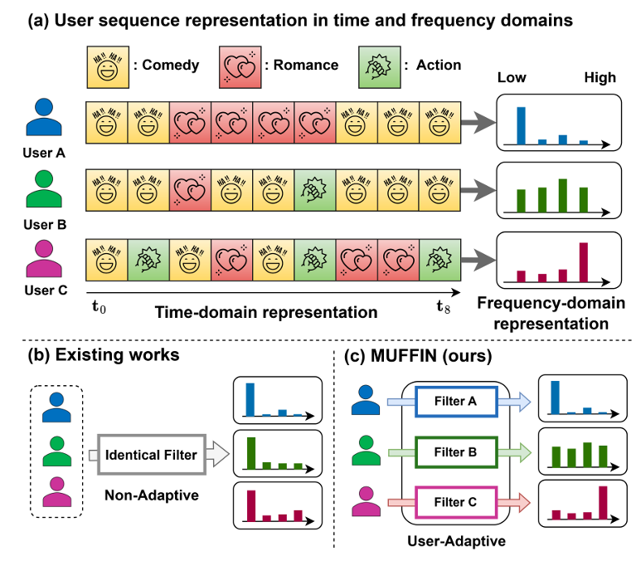
ATAI
AdvancedTechniqueof
Artificial Intelligence
ATAI
ChongqingUniversity _{AdvancedTechniqueof}
of Technology Artificial Intelligence
ChongqingUniversity of Technology
Motivation
Existing frequency domain SR models still face two major drawbacks:
(i) Limited frequency band coverage, often missing critical behavioral patterns in a specific frequency range.Existing models face a trade-off between full frequency spectrum analysis and detailed frequency band-specific modeling.
(ii) Lack of personalized frequency filtering, existing models apply identical frequency filters regardless of the different frequency characteristics of users.

Slide 3

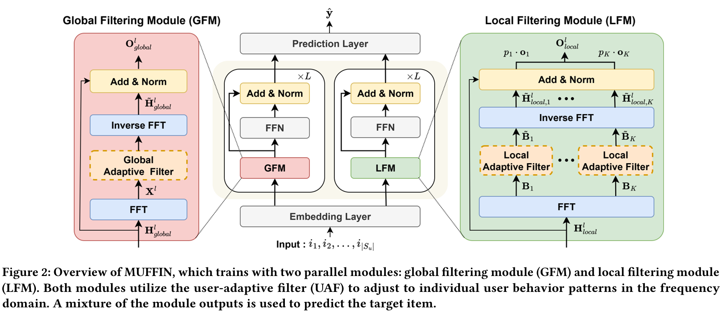
ChongqingUniversity of Technology
ATAI
AdvancedTechniqueof
Artificial Intelligence
ATAI
ChongqingUniversity _{AdvancedTechniqueof}
of Technology Artificial Intelligence
Overview

Slide 4
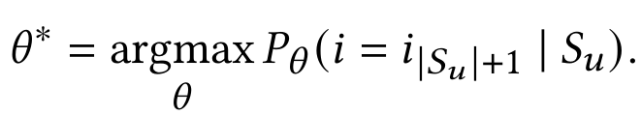
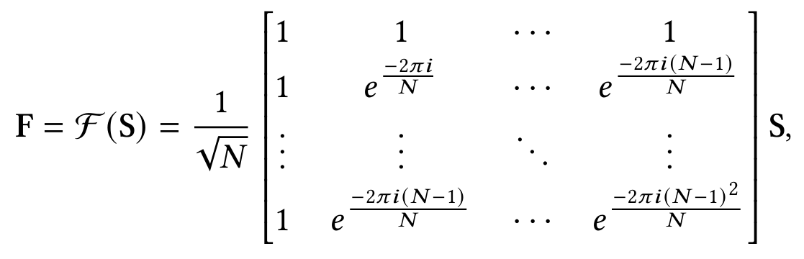

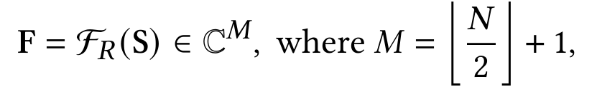
ChongqingUniversity of Technology
ATAI
AdvancedTechniqueof
Artificial Intelligence
ATAI
ChongqingUniversity _{AdvancedTechniqueof}
of Technology Artificial Intelligence
Method
(1)
(2)
(3)
(4)

Slide 5
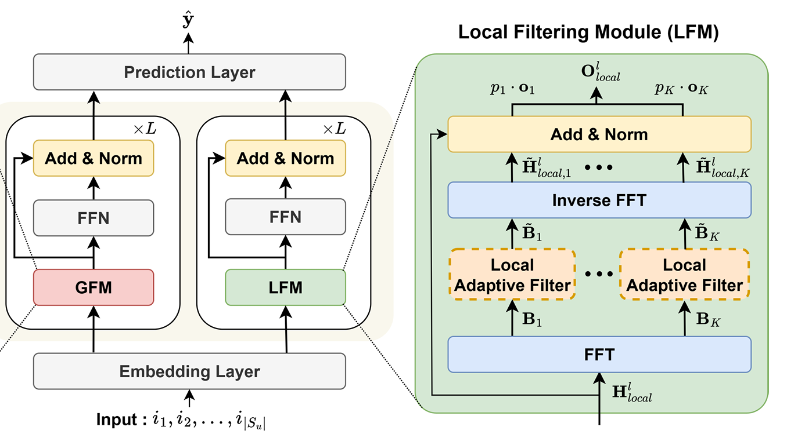



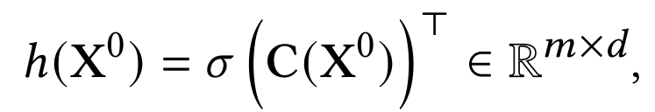
ChongqingUniversity of Technology
ATAI
AdvancedTechniqueof
Artificial Intelligence
ATAI
ChongqingUniversity _{AdvancedTechniqueof}
of Technology Artificial Intelligence
Method
(5)
(6)
(7)
(8)
(9)

Slide 6
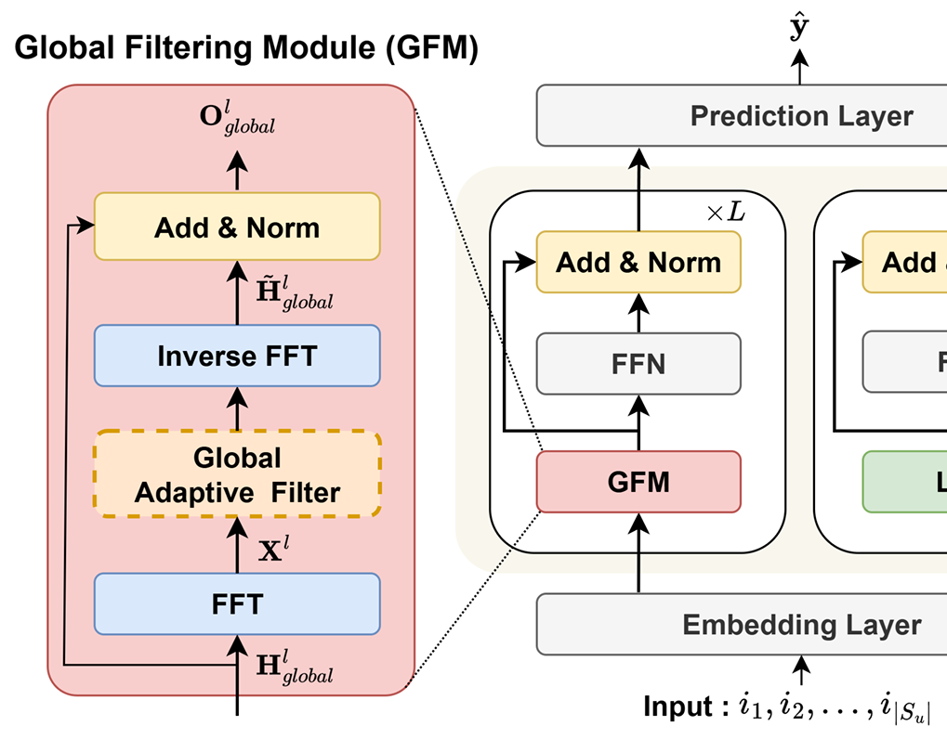
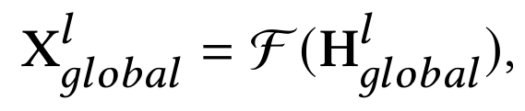
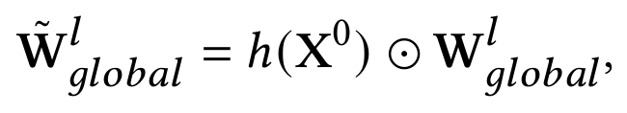
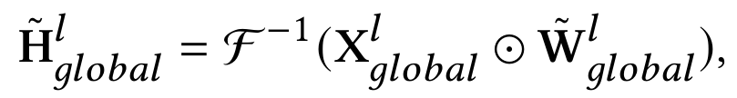
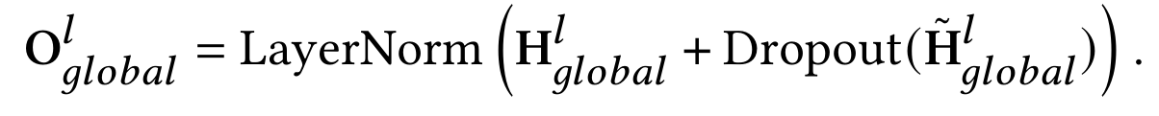
ChongqingUniversity of Technology
ATAI
AdvancedTechniqueof
Artificial Intelligence
ATAI
ChongqingUniversity _{AdvancedTechniqueof}
of Technology Artificial Intelligence
Method
(10)
(11)
(12)
(13)

Slide 7
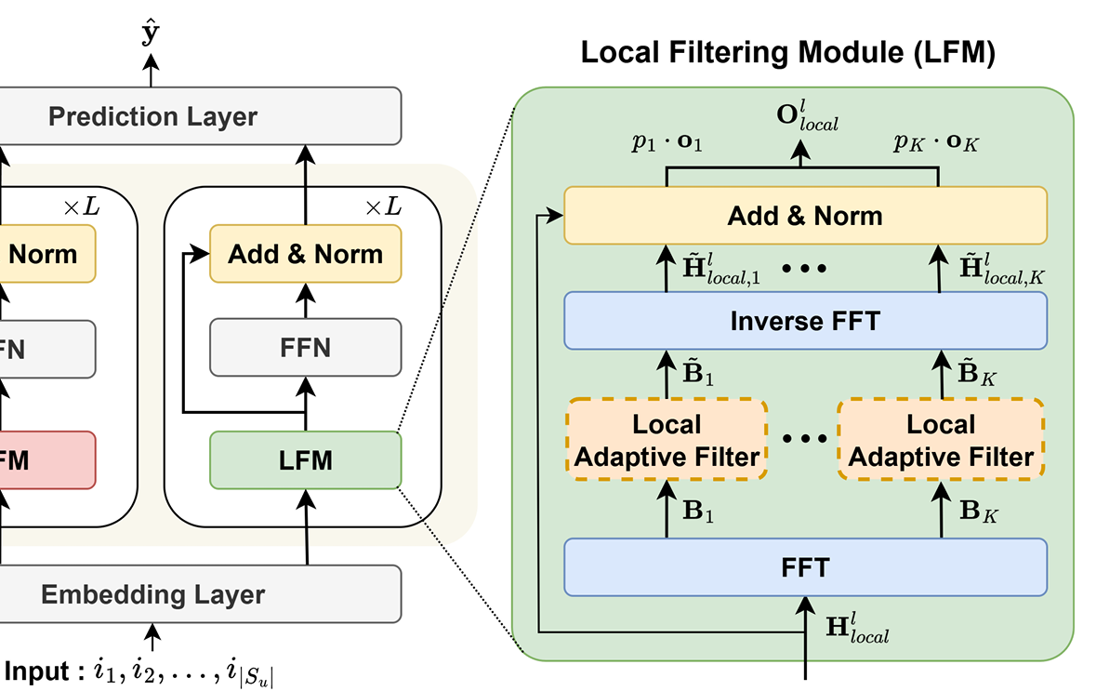
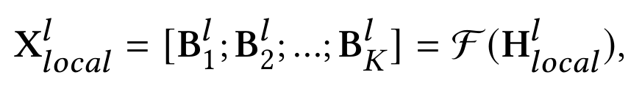
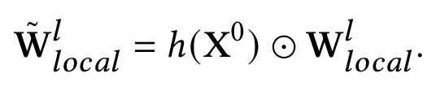
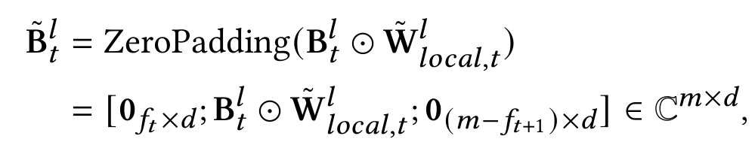
ChongqingUniversity of Technology
ATAI
AdvancedTechniqueof
Artificial Intelligence
ATAI
ChongqingUniversity _{AdvancedTechniqueof}
of Technology Artificial Intelligence
Method
(14)
(15)
(16)
(17)

Slide 8
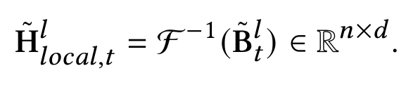
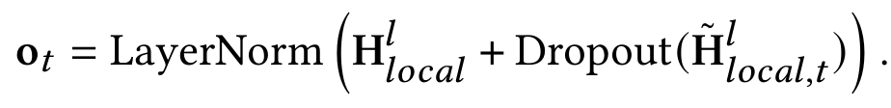

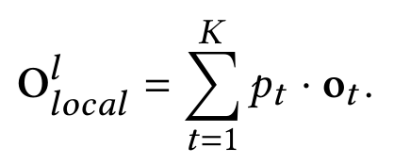

ChongqingUniversity of Technology
ATAI
AdvancedTechniqueof
Artificial Intelligence
ATAI
ChongqingUniversity _{AdvancedTechniqueof}
of Technology Artificial Intelligence
Method
(18)
(19)
(20)
(21)
(22)

Slide 9
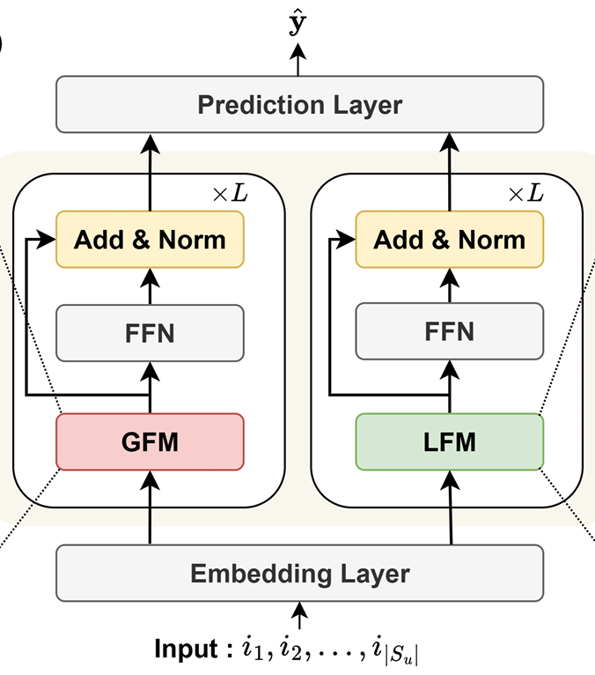
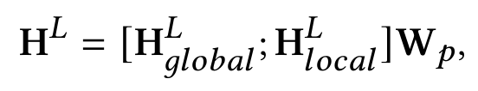
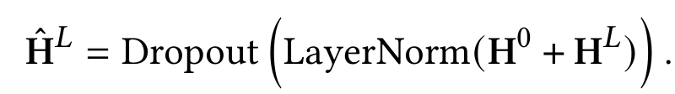
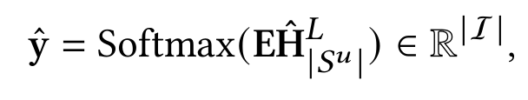
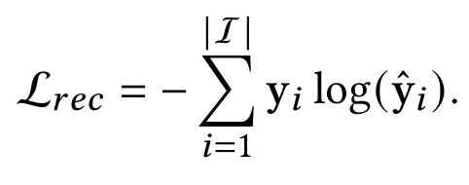
ChongqingUniversity of Technology
ATAI
AdvancedTechniqueof
Artificial Intelligence
ATAI
ChongqingUniversity _{AdvancedTechniqueof}
of Technology Artificial Intelligence
Method
(23)
(24)
(25)
(26)
(27)

Slide 10
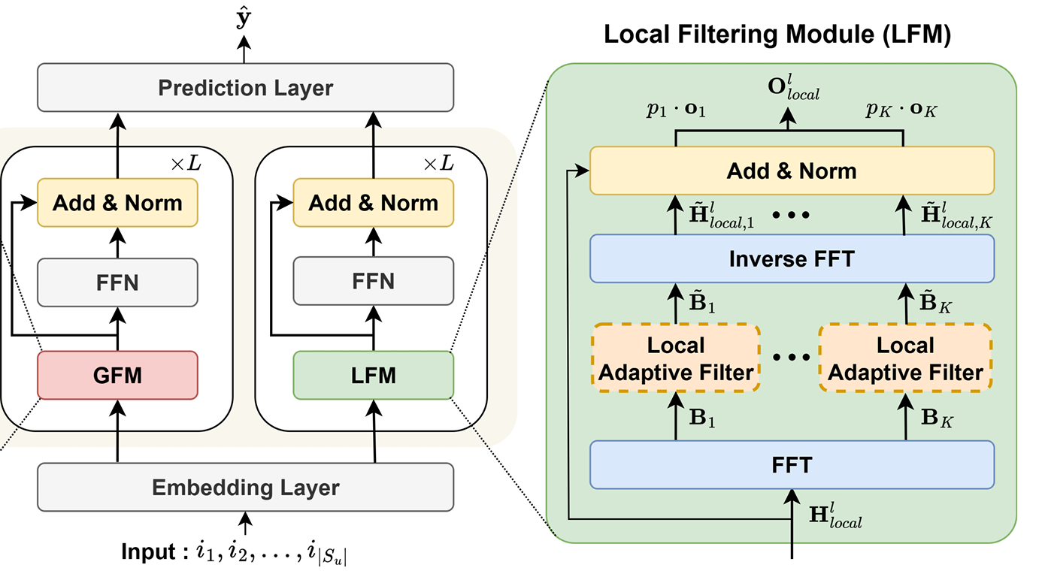
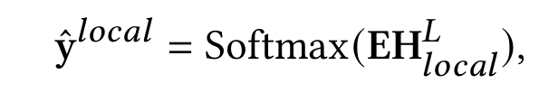
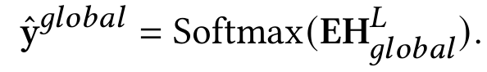
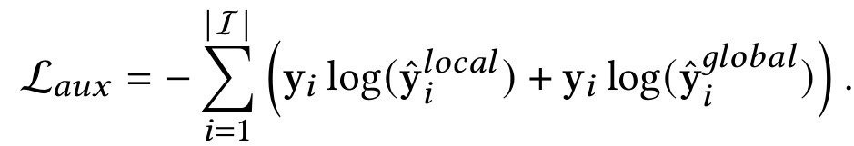
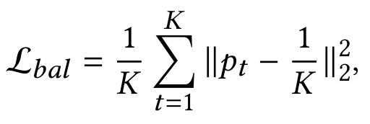

ChongqingUniversity of Technology
ATAI
AdvancedTechniqueof
Artificial Intelligence
ATAI
ChongqingUniversity _{AdvancedTechniqueof}
of Technology Artificial Intelligence
Method
(28)
(29)
(30)
(31)
(32)

Slide 11

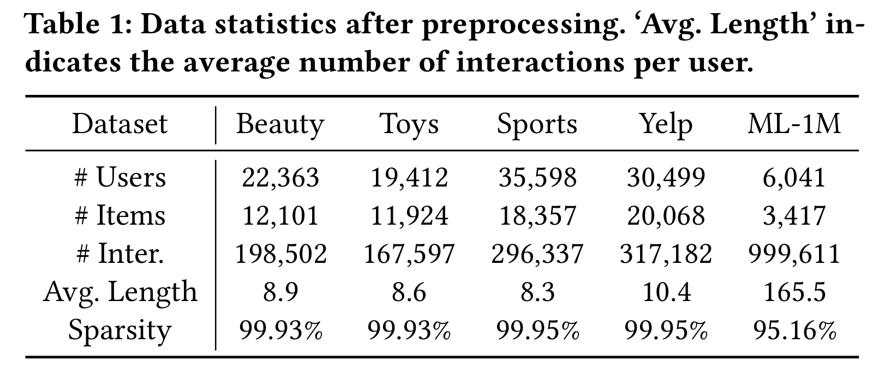
ATAI
AdvancedTechniqueof
Artificial Intelligence
ATAI
ChongqingUniversity _{AdvancedTechniqueof}
of Technology Artificial Intelligence
ChongqingUniversity of Technology
Experiments

Slide 12
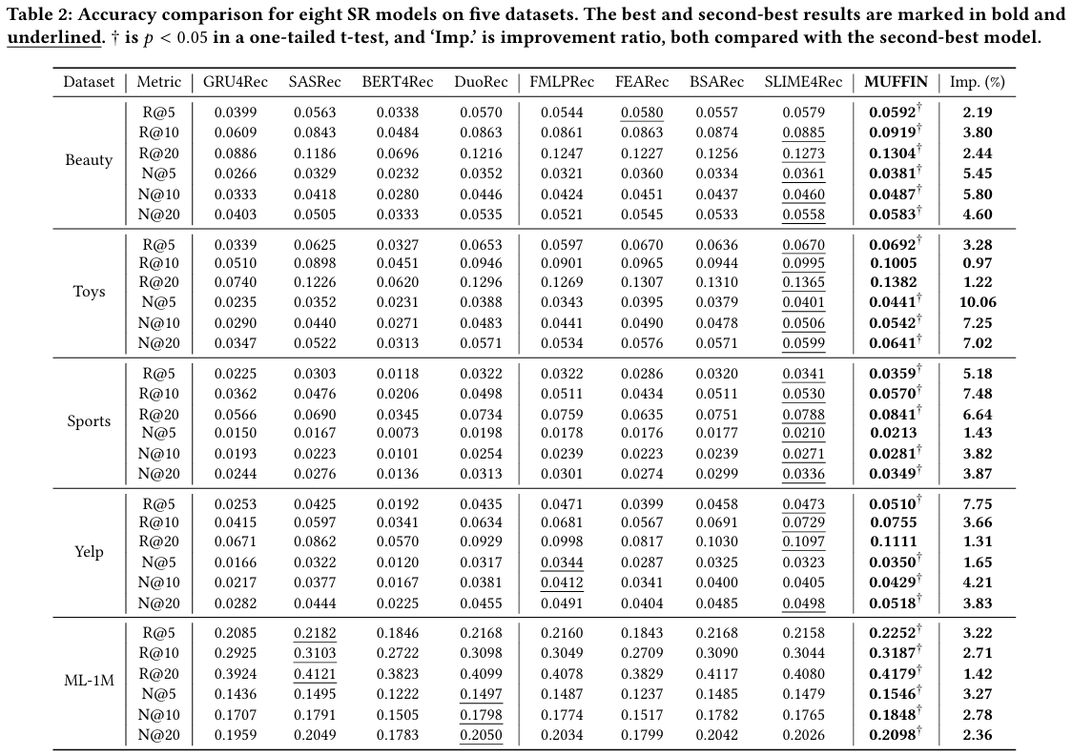
ATAI
AdvancedTechniqueof
Artificial Intelligence
ATAI
ChongqingUniversity _{AdvancedTechniqueof}
of Technology Artificial Intelligence
ChongqingUniversity of Technology
Experiments

Slide 13
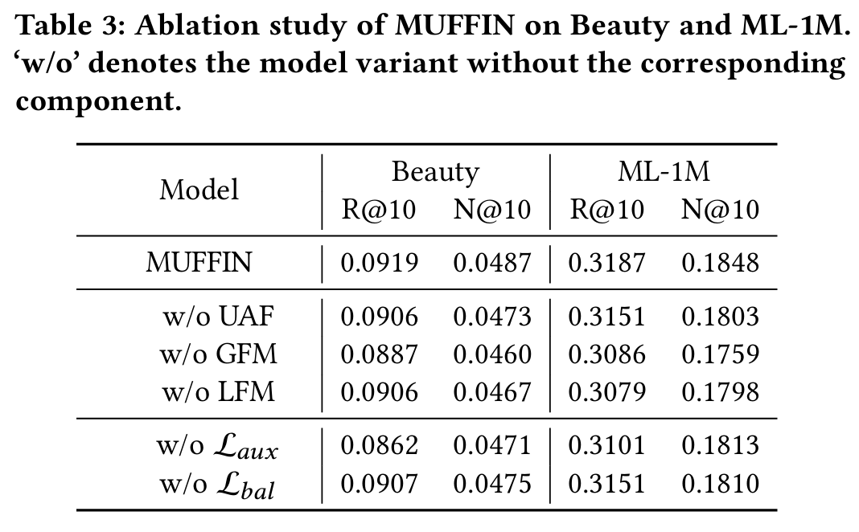
ATAI
AdvancedTechniqueof
Artificial Intelligence
ATAI
ChongqingUniversity _{AdvancedTechniqueof}
of Technology Artificial Intelligence
ChongqingUniversity of Technology
Experiments

Slide 14
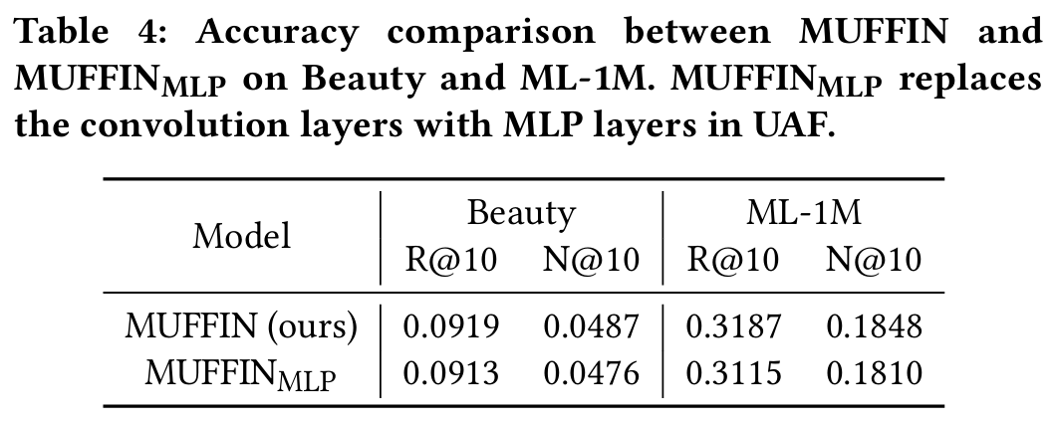
ATAI
AdvancedTechniqueof
Artificial Intelligence
ATAI
ChongqingUniversity _{AdvancedTechniqueof}
of Technology Artificial Intelligence
ChongqingUniversity of Technology
Experiments

Slide 15
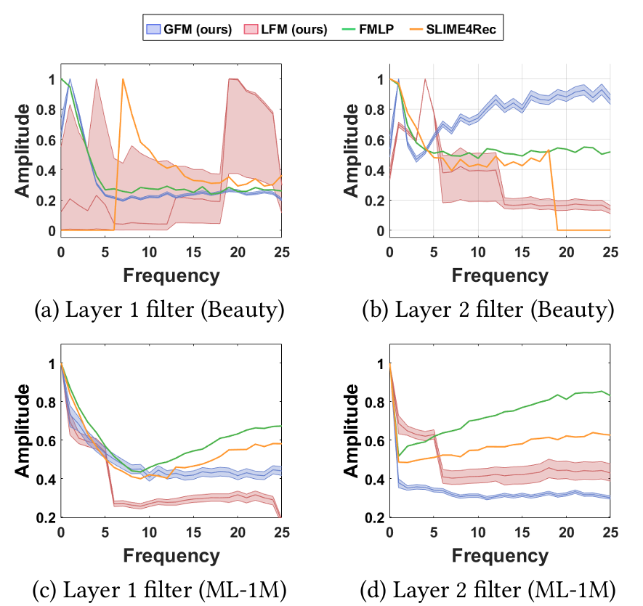
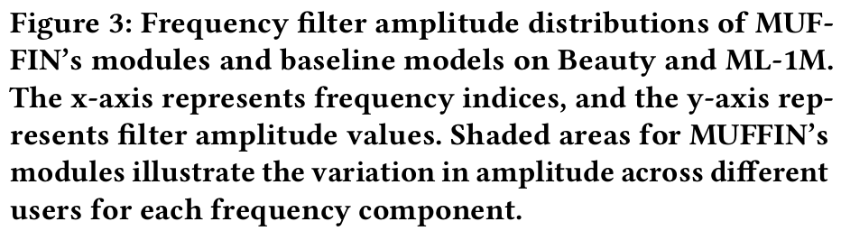
ATAI
AdvancedTechniqueof
Artificial Intelligence
ATAI
ChongqingUniversity _{AdvancedTechniqueof}
of Technology Artificial Intelligence
ChongqingUniversity of Technology
Experiments

Slide 16
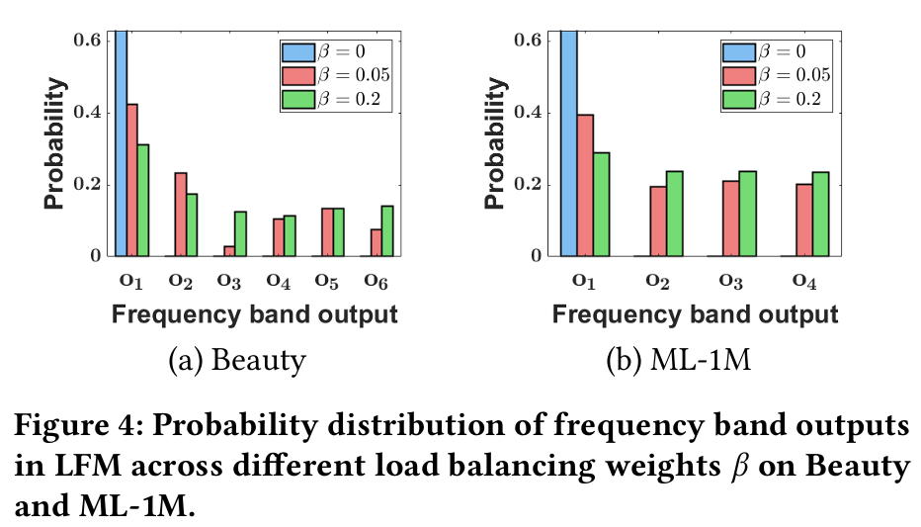
ATAI
AdvancedTechniqueof
Artificial Intelligence
ATAI
ChongqingUniversity _{AdvancedTechniqueof}
of Technology Artificial Intelligence
ChongqingUniversity of Technology
Experiments

Slide 17
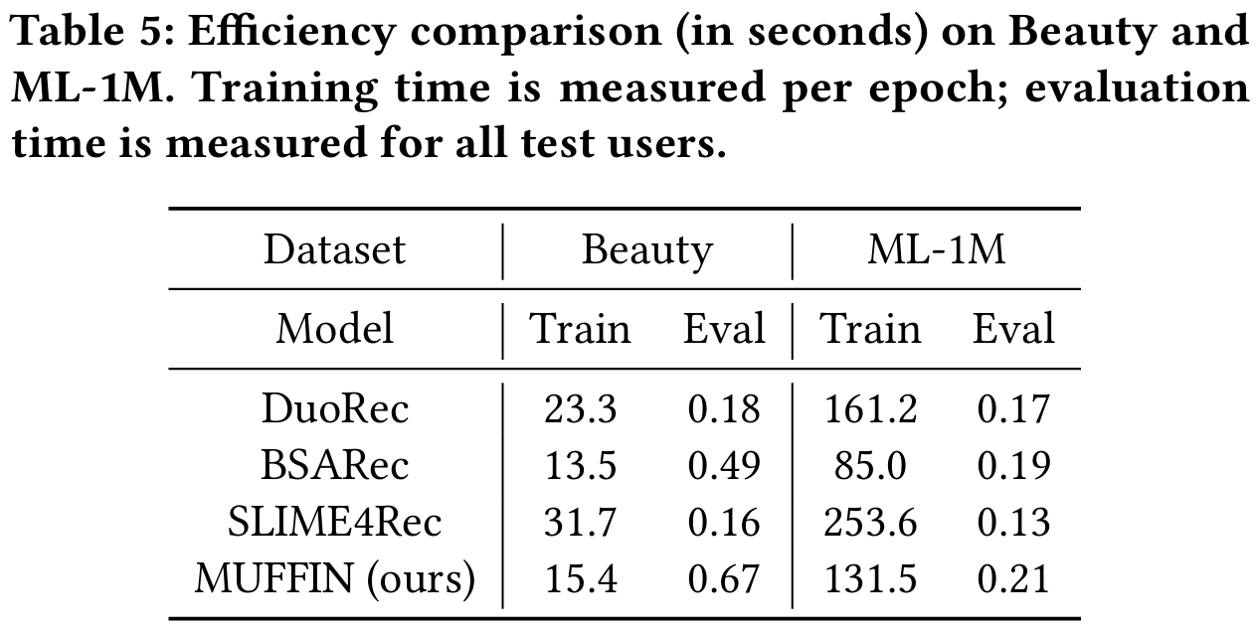
ATAI
AdvancedTechniqueof
Artificial Intelligence
ATAI
ChongqingUniversity _{AdvancedTechniqueof}
of Technology Artificial Intelligence
ChongqingUniversity of Technology
Experiments

Slide 18
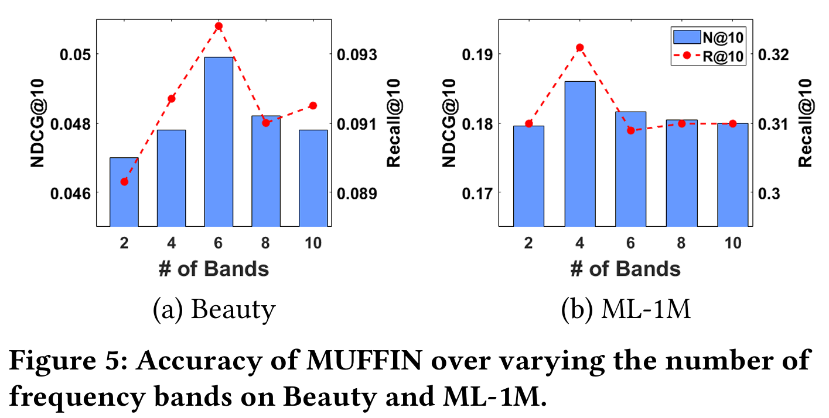
ATAI
AdvancedTechniqueof
Artificial Intelligence
ATAI
ChongqingUniversity _{AdvancedTechniqueof}
of Technology Artificial Intelligence
ChongqingUniversity of Technology
Experiments

Slide 19
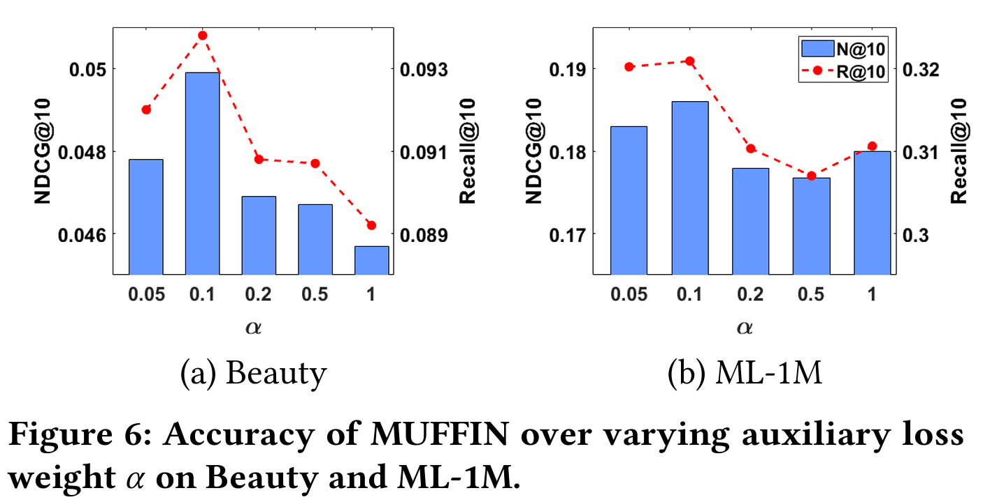
ATAI
AdvancedTechniqueof
Artificial Intelligence
ATAI
ChongqingUniversity _{AdvancedTechniqueof}
of Technology Artificial Intelligence
ChongqingUniversity of Technology
Experiments

Slide 20
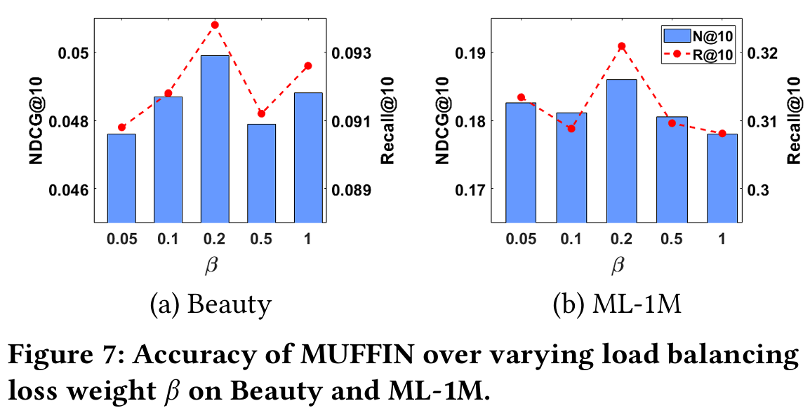
ATAI
AdvancedTechniqueof
Artificial Intelligence
ATAI
ChongqingUniversity _{AdvancedTechniqueof}
of Technology Artificial Intelligence
ChongqingUniversity of Technology
Experiments

Slide 21


ChongqingUniversity of Technology
ATAI
AdvancedTechniqueof
Artificial Intelligence
ATAI
ChongqingUniversity _{AdvancedTechniqueof}
of Technology Artificial Intelligence
Thanks!

